Slide 1

Modern Analytics Academy “Vignettes”
Synapse Managed Virtual Network
https://aka.ms/maa
Alan Kleinert
Sr. Cloud Solution Architect

Slide 2
Agenda
Synapse Managed Virtual Network
  Overview
  Reference Architecture
  Advantages
  Notable Mentions
  Demo
  Resources

Slide 3

Synapse Managed Virtual Network - Overview
What is it?
When to use it?
Why use it?
Notes:
What is it?
Managed Virtual Network is a networking feature within Azure Synapse Analytics that enables secure and private communication between Azure resources. It allows for the creation of a virtual network that’s fully managed by Synapse which ensures network isolation and enhanced security.
When to use it? Often times customers and partners create solutions that contain sensitive data. To limit risk of data breach and security threats it’s important to isolate services and reduce exposure.
Require network isolation and segmentation for enhanced security
Public Network closed off
Why use it?
Less network overhead and management
Scalable native integration runtime

Slide 4
Reference Architecture – Integration Runtime

Slide 5
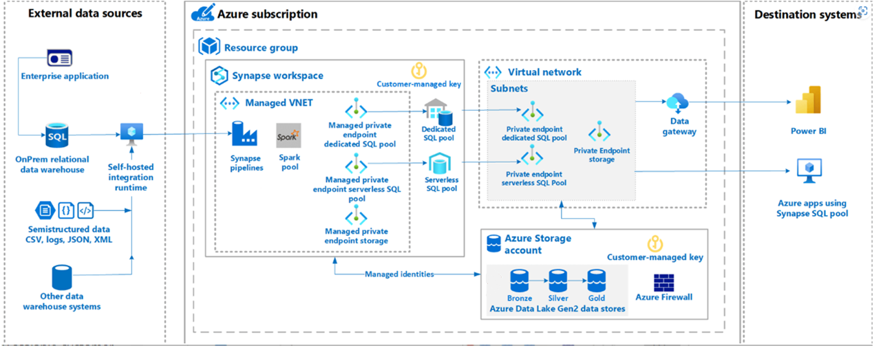
Reference Architecture – Managed Virtual Network

Slide 6
Synapse Managed Virtual Network - Advantages
With a Managed workspace Virtual Network you can offload the burden of managing the Virtual Network to Azure Synapse.
No need to configure inbound NSG rules on your own Virtual Networks to allow Azure Synapse management traffic to enter your Virtual Network. Misconfiguration of these NSG rules causes service disruption for customers.
If your workspace has a Managed workspace Virtual Network, Data integration and Spark resources are deployed in it. A Managed workspace Virtual Network also provides user-level isolation for Spark activities because each Spark cluster is in its own subnet.
Managed workspace Virtual Network along with Managed private endpoints protects against data exfiltration.
Synapse Pipelines can leverage Native Azure Integration Runtime

Slide 7
Notable Mentions
You cannot change this workspace configuration after the workspace is created. For example, you cannot reconfigure a workspace that does not have a Managed workspace Virtual Network associated with it and associate a Virtual Network to it. Similarly, you cannot reconfigure a workspace with a Managed workspace Virtual Network associated to it and disassociate the Virtual Network from it.
Dedicated SQL pool and serverless SQL pool are multi-tenant capabilities and therefore reside outside of the Managed workspace Virtual Network. Intra-workspace communication to dedicated SQL pool and serverless SQL pool use Azure private links. These private links are automatically created for you when you create a workspace with a Managed workspace Virtual Network associated to it.
Managed Virtual Network exists for both Azure Data Factory and Synapse Pipelines
Managed Virtual network does not work for on prem sources and you will still need a self hosted IR for connectivity

Slide 8
Demo

Slide 9
Resources
    Managed virtual network - Azure Synapse Analytics | Microsoft Learn
    Managed private endpoints - Azure Synapse Analytics | Microsoft Learn
    Connect to a secure storage account from your Azure Synapse workspace - Azure Synapse Analytics | Microsoft Learn

Slide 10
Thank you!
Modern Analytics Academy “Vignettes”
Synapse Managed Virtual Network
https://aka.ms/maa

